Slide 1
Fundamentals of Python
Unit 3 and 4

Slide 2
Goals for this workshop.
summarizing data
basics of probability
normal distribution
central limit theory
narrative analytics
capstone report

Slide 3
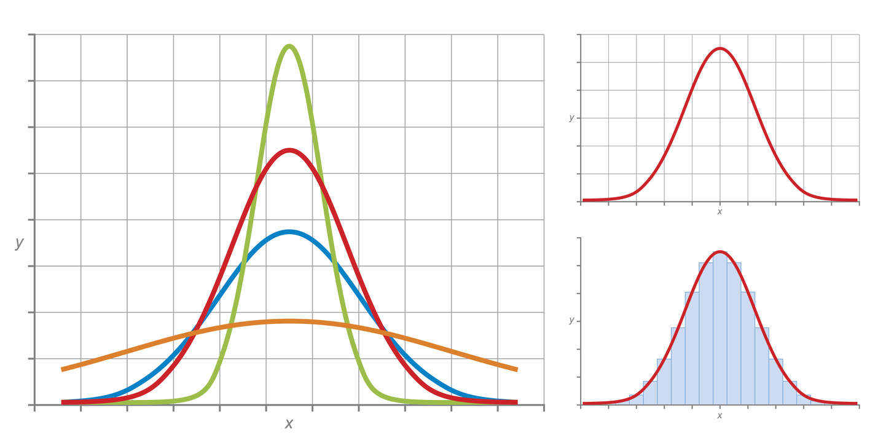
Summarizing Data
randomly select a subset of data from the population to learn about the population as a whole
take data about a sample and reduce the complexity of that data into understandable and accurate summaries, known as statistics
use the sample statistics to infer information about the entire population from which the sample is taken
Statistics can describe either an individual variable or the relationships among two or more variables.

Slide 4
Summarizing Data (cont’d)
two characteristics of most interest are the central tendency and the variance
central tendency describes a point around which datapoints in a variable cluster (most common measures are the mean the median, and the mode)
variance of a variable describes how much values differ from the central tendency, and how much they differ from each other
if all the values in a variable are close to the central tendency, then variance is said to be low
standard deviation is the square root of the variance

Slide 5
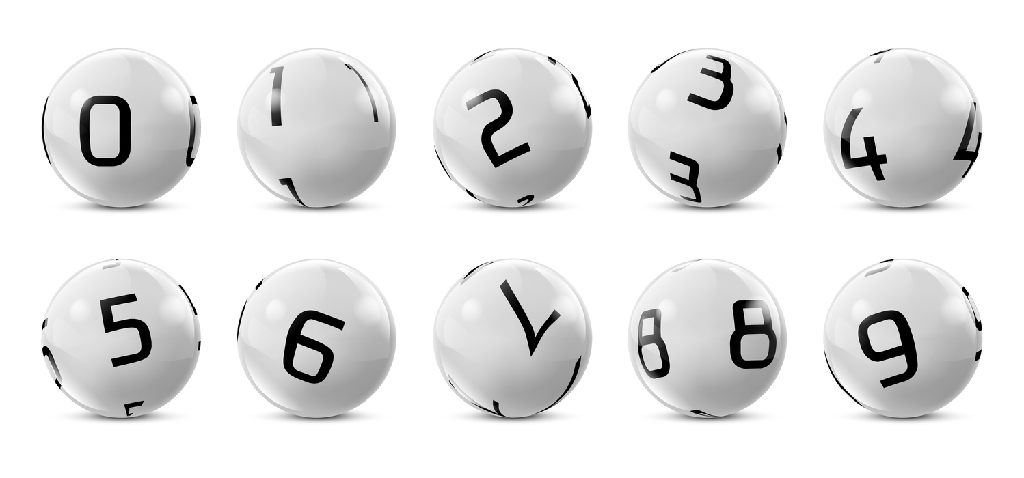
Basics of Probability
probability is a way of quantifying the likelihood of a future outcome
frequentist - probability as describing how often a particular outcome would occur in an experiment if that experiment were repeated over and over
bayesian - probability as describing how likely an observer expects a particular outcome to be in the future, based on previous experience and expert knowledge.
randomness - a situation where all possible outcomes are equally likely

Slide 6
Basics of Probability (cont’d)
data scientists leverage the concept of randomness to gather a representative sample from the population
using randomness, each element of a population has an equal chance of being chosen for the sample
an event is independent of other events in the sample space if the outcome of that event is not affected by the outcome of other events in the sample space

Slide 7
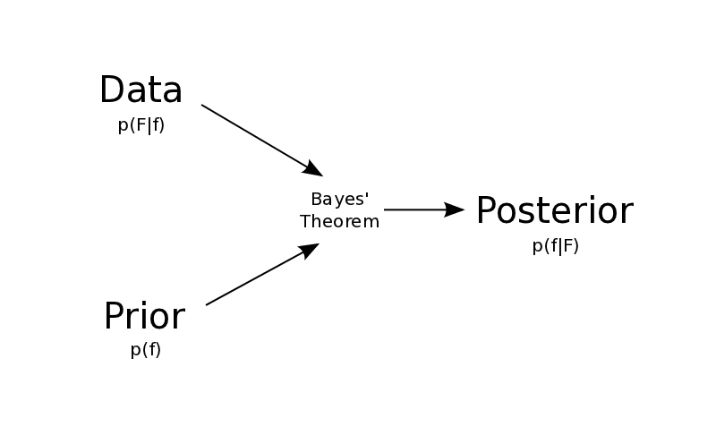
Bayes Rule
P(A | B) = P(B | A) * P(A) / P(B)
OR
P(A | B) = P(B | A) * P(A) / [P(A)*P(B|A) + P(A~)*P(B|A~)]
the probability of A given B equals the probability of B given A, times the probability of A, divided by the probability of B.

Slide 8
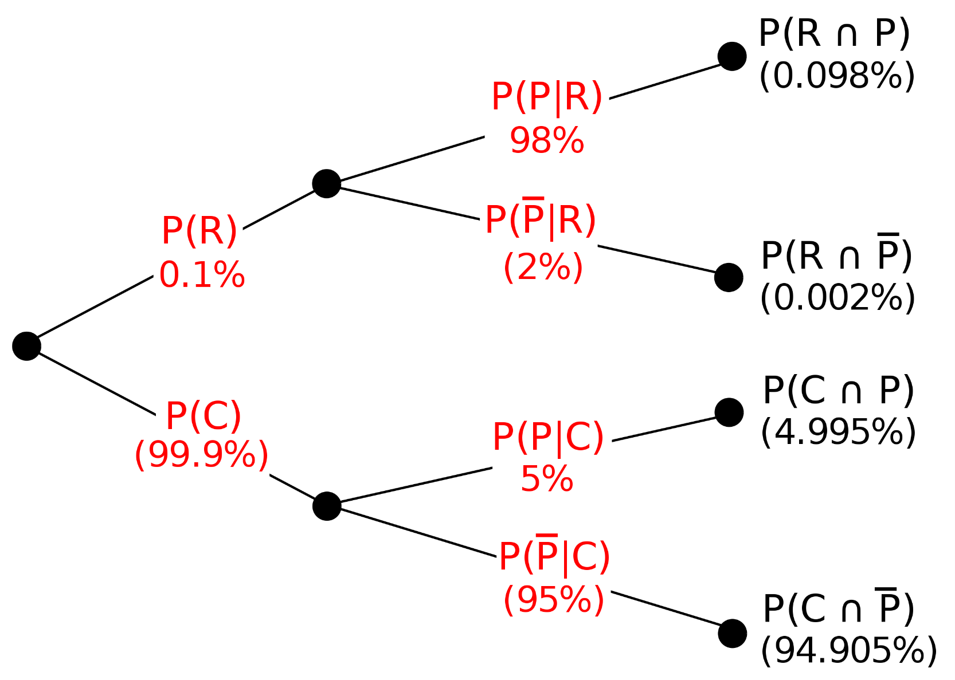

Slide 9
Normal Distribution
data is described as "normal," or "normally distributed," if most values cluster in the center of the range, with the rest tapering off symmetrically to the left and the right
the mean and median of a normally distributed variable are equal
approximately 68% of the values in a normally-distributed variable fall within 1 standard deviation above or below the mean, 95% of values fall within two standard deviations of the mean, and 99.7% of values fall within three standard deviations of the mean.

Slide 10
Central Limit Theorem
when sampling from a population (of any distribution), as the sample size gets larger the sample means tend to follow a normal probability distribution clustering around the true population mean
the more non-normal the population the larger the samples need to be,
statistics can be calculated, and population parameters estimated, even when the distribution of a population is unknown

Slide 11
Narrative Analytics
Narrative analytics is the idea of telling a story with data, and it will play a key role in everything you do in this course and throughout your career in data science.
Everything contains some element of narrative to it. Every piece of data says something, and how you present those points inherently affects how such data is consumed.
There are several key things to keep in mind when working with data to ensure that you arrive at the closest thing to truth you can find.
Firstly, try not to decide a story before you look into the data.
Always try to ask what else an answer could mean. When you perform analytics, there is often a conclusion that is easiest to draw. Spending the time to question that conclusion is one of the key features of a good data scientist.

Slide 12
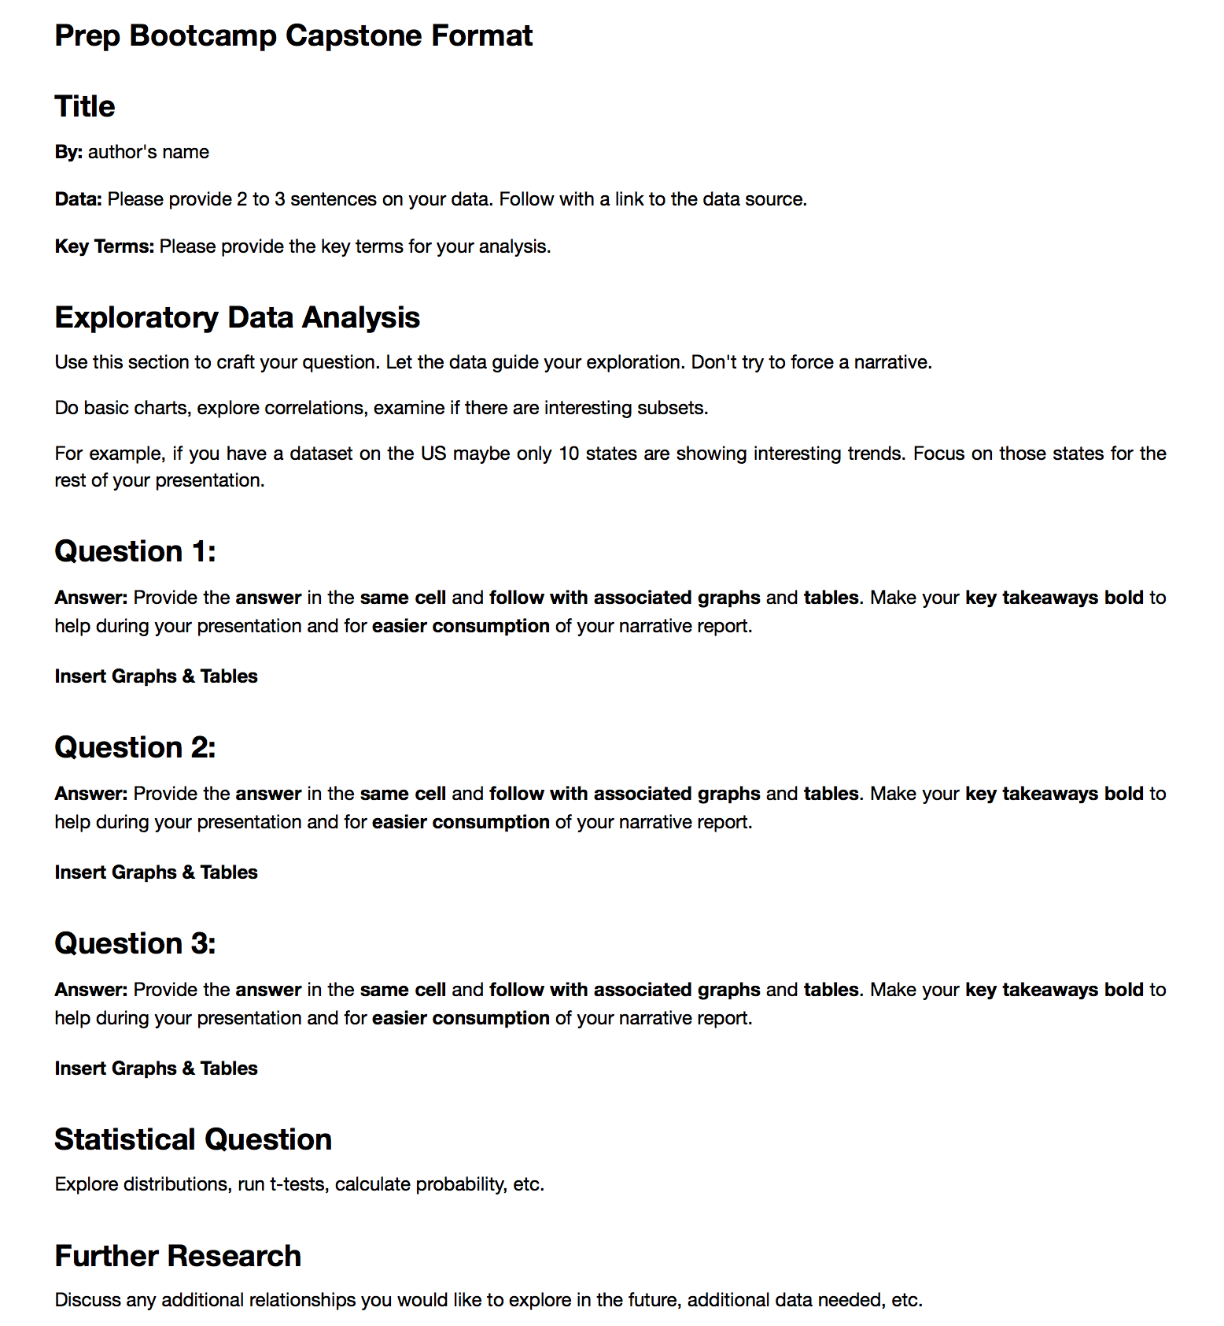
Capstone Report
Type to enter a caption.

Slide 13
Example Capstone
Predicting Credit Card Defaults

